Slide 1
Knowledge Representation

Slide 2
Finding appropriate representation is a major part of problem solving

Slide 3
Need to represent knowledge about the world
Types of knowledge
objects
events
procedures
relations
mental states
meta knowledge

Slide 4
Closed worlds and Open worlds
Do we know the world completely? Or is our knowledge incomplete?
The closed world assumption says that
What you know is all there is to know about the world.
This implies that if you do not know something, it is false.
When we look at this idea of logic in programming language: Prolog there is this notion of negation by failure
If you fail to show that it is true then it must be false
It’s not saying that its false because you don’t know whether it is true or false
In the real world is not like that, there are so many things that we may not take cognisance of and which may be relevant to what we are trying to show

Slide 5
Closed worlds and Open worlds
The open worlds assumption says we have only partial knowledge of the world around us.
This implies that the conclusions we make now may have to be withdrawn when more facts come to light.
This is also sometimes called as non monotonic reasoning

Slide 6
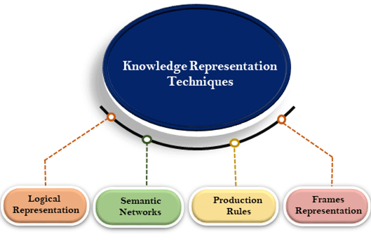

Slide 7
Difference between traditional programming and AI approach
Connection between input and output may be found at runtime and not encoded by the programmer.
In traditional programming programmer implements the solution steps, for problems in a given domain, into a program.
In AI programs the programmer implements a problem solving strategy in a more domain independent form.
AI program takes a domain knowledge and a given problem and produces the solution steps, based on the strategy it embodies.
Both problem solving strategy and domain description call upon knowledge representation approaches.

Slide 8
Difference between traditional programming and AI approach

Slide 9
Knowledge based problem solving agent

Slide 10
Human gets knowledge by experience, by books, by experience of other humans.
But computers are not yet completely natural language enabled.
They need crisp, unambiguous, precise formalism for representing and manipulating knowledge

Slide 11
Logical Representation
Logical representation is a language with some concrete rules which deals with propositions and has no ambiguity in representation.
Logical representation means drawing a conclusion based on various conditions.
This representation lays down some important communication rules.
It consists of precisely defined syntax and semantics which supports the sound inference.
Each sentence can be translated into logics using syntax and semantics.

Slide 12
Logical Representation
Syntax:
Syntaxes are the rules which decide how we can construct legal sentences in the logic.
It determines which symbol we can use in knowledge representation.
How to write those symbols.
Semantics:
Semantics are the rules by which we can interpret the sentence in the logic.
Semantic also involves assigning a meaning to each sentence.
Logical representation can be categorised into mainly two logics:
Propositional Logics
Predicate logics

Slide 13
FOL
Domain: A set of Individuals
Statements in logic (Predicate): relations about those individuals
From the perspective of knowledge representation the question is what should those individuals in the domain be?
We cannot represent the physical world as seen by physics
That is made of some fundamental particles
We need to represent concepts in our cognitive models
A person, for example, Socrates
But if Socrates is an individual in the domain
What about the right hand of Socrates?
If the right hand another individual? What about his index finger?
What about concepts like water, air, and sky?
These are not individuals (it is not clear whether they are individuals)
Or even categories
What does a “glass of water” represent?

Slide 14
Aggregation and Reification (Abstraction)
Individuals in our cognitive models are not the individual elements in the domain- which are the elementary particles.
Instead we invent our own concepts in our heads
People, trees, dogs, nations, organizations, football teams, rivers etc.
We also think of concepts like length and colour.
Are these individuals in some domain
These are all abstract or reified composites that we think of as individuals
When we say “the rose is red” we mean an individual rose
But when we say “violets are blue” we mean categories
We also think of time, events, actions
Complex entities have some simple entities.
In our conceptual domain (that is different from physical domain)

Slide 15
Hierarchies of Structured Knowledge
Two types of hierarchies in structured knowledge :
Aggregation hierarchy
Is-part-of: Wheel is part of car…
Tells us how different components come together to form a larger abstract (physical) entity like car is made up of steering, wheels, seats etc. wheels are made up of ……etc.
We have to define the level of aggregation hierarchy- up to what level down
Obviously we can’t go to the level of fundamental particles. We don’t have the computational capability to do that.
Abstraction hierarchies:
Is-A
All these elements belong to the same category
Example: all individual cats to cat category, all individual dogs to dog category… etc. all cats and dogs …etc. categories to mammals so cat is a mammal, dog is a mammal etc.

Slide 16
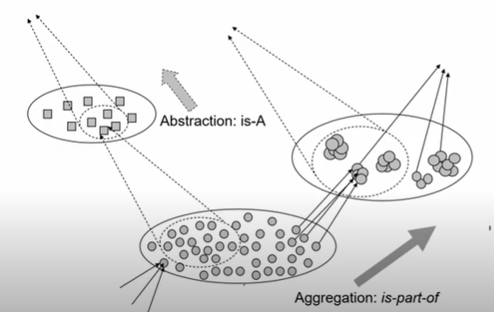
Hierarchies of Structured Knowledge

Slide 17
Beyond categories and concepts
The language of logic is concerned with sentences.
Sentence is something that is true or false.
But knowledge about the world goes beyond simple sentences
Complex organisms can be described only by collecting a large number of sentences and organizing them into meaningful structures.
That we call as hierarchies.

Slide 18
Situational Knowledge
We can say that an agent is intelligent in a situation
Intelligence can be shown in a domain in a particular situation
We do abductive reasoning as we have situational knowledge
What happens in a restaurant
What happens in a hospital etc.
So we need that kind of situational knowledge
If you are blindfolded and touching something
How can you guess that it is an elephant?
You have to know about elephants in the first place.

Slide 19
Knowledge structure
How does one represent knowledge about bookstore?
Or about restaurants, or about dental clinics?
We can do it by putting together different kind of sentences which will describe those entities
In some sense we collect and organize individual bits of facts about the typical knowledge about these entities
These will be aggregated representations
Roger Schank called such structures Scripts
Marvin Minsky called them Frames
And gave rise to the idea of Object Oriented Programming Systems

Slide 20
Taxonomies
One approach to representing knowledge would be to have a large pool of sentences
An algorithm for making inferences would search through the sentences to make the right connections
This would be at the cost of computational complexity
Instead we tend to organize facts into taxonomies
Taxonomies facilitate inheritance
For example, mammals have two eyes
Implies that cats have two eyes
Taxonomies facilitate compactness
We only need to store a property in a super class
And inherit it into a subclass
Minsky’s frames led to OOPs

Slide 21
First order logic allows us to talk about
Domain
Individuals in the domain
Relations between individuals
Relations between categories
Notion of vars and quantifiers
First order logic does not involve time
First order logic is change less (it is not the case that something was true yesterday but not today)
It is called as mathematical logic
It’s a logic of relations (predicates capture relations between individuals and so on)

Slide 22
First Order Logic (FOL)
The domain D of FOL is a set of individuals
Predicates of FOL capture
Relation between individuals. For example, Friend(Priya, Sonam)
Categories or concepts. For example, Man(Socrates)
Relation between categories. For example, ∀x (Deer(x) => Mammal(x))
Relations between named relations. For example, ∀x,y (Brother(x,y) => Sibling(x,y)
Depending on the types of predicates we choose, we need to add such rules to our logic
Inference involve traversing from known to the unknown
Rules of inference facilitate this traversal
The more the number of predicates the more the rules

Slide 23
To avoid the tsunami of rules of inferences
How to choose the set of predicates so that our reasoning becomes tractable and computationally feasible.
So that our representation is compact and canonical
Canonical set of predicate
Represent only the core concept
Same thing is not represented in many different ways
If we want input in any natural language we need to map into set of canonical conceptual representation that is not as rich in words as

Slide 24
Advantages of logical representation
Logical representation enables us to do logical reasoning.
Logical representation is the basis for the programming languages.

Slide 25
Disadvantages of logical Representation
Logical representations have some restrictions and are challenging to work with.
Logical representation technique may not be very natural, and inference may not be so efficient.
First order logic is computationally very expensive
And very often all its power is not required in the kind of reasoning that we want to do
Logic of noun prases

Slide 26
Production Rules
Production rules system consist of (condition, action) pairs which mean, "If condition then action". It has mainly three parts:
The set of production rules
Working Memory
The recognize-act-cycle

Slide 27
In production rules agent checks for the condition and if the condition exists then production rule fires and corresponding action is carried out.
The condition part of the rule determines which rule may be applied to a problem.
And the action part carries out the associated problem-solving steps.
This complete process is called a recognize-act cycle.

Slide 28
The working memory contains the description of the current state of problems-solving and rule can write knowledge to the working memory.
This knowledge match and may fire other rules.
If there is a new situation (state) generates, then multiple production rules will be fired together, this is called conflict set.
In this situation, the agent needs to select a rule from these sets, and it is called a conflict resolution.

Slide 29
Example:
IF (at bus stop AND bus arrives) THEN action (get into the bus)
IF (on the bus AND paid AND empty seat) THEN action (sit down).
IF (on bus AND unpaid) THEN action (pay charges).
IF (bus arrives at destination) THEN action (get down from the bus).

Slide 30
There are two ways to pursue such a search that are forward and backward reasoning. The significant difference between both of them is that forward reasoning starts with the initial data towards the goal. Conversely, backward reasoning works in opposite fashion where the purpose is to determine the initial facts and information with the help of the given results.

Slide 31
Comparison Chart
BASIS FOR COMPARISON | FORWARD REASONING | BACKWARD REASONING
Basic | Data-driven | Goal driven
Begins with | New Data | Uncertain conclusion
Objective is to find the | Conclusion that must follow | Facts to support the conclusions
Type of approach | Opportunistic | Conservative
Flow | Incipient to consequence | Consequence to incipient

Slide 32
Forward Reasoning
The solution of a problem generally includes the initial data and facts in order to arrive at the solution.
These known facts and information is used to deduce the result.
For example, while diagnosing a patient the doctor first check the symptoms and medical condition of the body such as temperature, blood pressure, pulse, eye colour, blood, etcetera.
After that, the patient symptoms are analysed and compared against the predetermined symptoms of diseases.
Then the doctor is able to provide the medicines according to the symptoms of the patient.
So, when a solution employs this manner of reasoning, it is known as forward reasoning.

Slide 33
Steps that are followed in the forward reasoning
The inference engine explores the knowledge base with the provided information for constraints whose precedence matches the given current state.
In the first step, the system is given one or more than one constraints.
Then the rules are searched in the knowledge base for each constraint. The rules that fulfil the condition are selected(i.e., IF part).
Now each rule is able to produce new conditions from the conclusion of the invoked one. As a result, THEN part is again included in the existing one.
The added conditions are processed again by repeating step 2.
The process will end if there is no new conditions exist.

Slide 34
Backward Reasoning
The backward reasoning is inverse of forward reasoning in which goal is analysed in order to deduce the rules, initial facts and data.
We can understand the concept by the similar example given in the above definition, where the doctor is trying to diagnose the patient with the help of the inceptive data such as symptoms.
However, in this case, the patient is experiencing a problem in his body, on the basis of which the doctor is going to prove the symptoms.
This kind of reasoning comes under backward reasoning.

Slide 35
Steps that are followed in the backward reasoning
In this type of reasoning, the system chooses a goal state and reasons in the backward direction.
Now, let’s understand how does it happens and what steps are followed.
Firstly, the goal state and the rules are selected where the goal state reside in the THEN part as the conclusion.
From the IF part of the selected rule the subgoals are made to be satisfied for the goal state to be true.
Set initial conditions important to satisfy all the subgoals.
Verify whether the provided initial state matches with the established states.
If it fulfils the condition then the goal is the solution otherwise other goal state is selected.

Slide 36
Conflict Resolution
We have two rules, Rule 1 and Rule 2, with the same IF part.
Thus both of them can be set to fire when the condition part is satisfied.
These rules represent a conflict set.
The inference engine must determine which rule to fire from such a set.
A method for choosing a rule to fired in a given cycle is called conflict resolution.
In forward chaining, BOTH rules would be fired.
Rule 1 is fired first as the topmost one, and as a result, its THEN part is executed.
However, Rule 2 is also fired because the condition part of this matches.

Slide 37
Methods used for conflict resolution
Fire the rule
with the highest priority. In simple applications, the priority can be established by placing the rules in an appropriate order in the knowledge base. Usually this strategy works well for expert systems with around 100 rules.
That is most specific rule. This method is also known as the longest matching strategy. It is based on the assumption that a specific rule processes more information than a general one.
That uses the data most recently entered in the database.
This method relies on time tags attached to each fact in the database.

Slide 38
Advantages of Production rule
The production rules are expressed in natural language.
The production rules are highly modular, so we can easily remove, add or modify an individual rule.

Slide 39
Disadvantages of Production rule
Production rule system does not exhibit any learning capabilities, as it does not store the result of the problem for the future uses.
During the execution of the program, many rules may be active hence rule-based production systems are inefficient.

Slide 40
Structured knowledge representation
Semantic Nets,
frames,
Conceptual dependency,
Scripts

Slide 41
Semantic Networks Representation
Semantic networks are alternative of predicate logic for knowledge representation.
In Semantic networks, we can represent our knowledge in the form of graphical networks.
This network consists of nodes representing objects and arcs which describe the relationship between those objects and arc labels that denote particular relations.
Semantic networks can categorize the object in different forms and can also link those objects.
Semantic networks are easy to understand and can be easily extended.

Slide 42
This representation consist of mainly two types of relations:
IS-A relation (Inheritance)
Kind-of-relation
Example: Following are some statements which we need to represent in the form of nodes and arcs.
Statements:
Jerry is a cat.
Jerry is a mammal
Jerry is owned by Priya.
Jerry is white colored.
All animals are mammal.

Slide 43
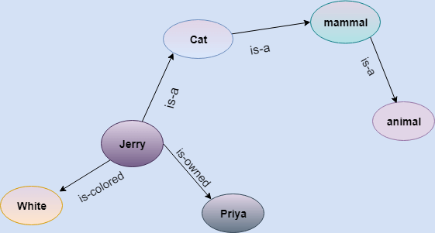

Slide 44
Drawbacks in Semantic representation
Semantic networks take more computational time at runtime as we need to traverse the complete network tree to answer some questions.
It might be possible in the worst case scenario that after traversing the entire tree, we find that the solution does not exist in this network.
Semantic networks try to model human-like memory (Which has 86 billion neurons and links) to store the information, but in practice, it is not possible to build such a vast semantic network.
These types of representations are inadequate as they do not have any equivalent quantifier, e.g., for all, for some, none, etc.
Semantic networks do not have any standard definition for the link names.
These networks are not intelligent and depend on the creator of the system.

Slide 45
Advantages of Semantic network
Semantic networks are a natural representation of knowledge.
Semantic networks convey meaning in a transparent manner.
These networks are simple and easily understandable.

Slide 46
Frames Representation
A frame is a collection of attributes or slots and associated values that describe some real world entity
Each frame represents –
a class, or
an instance (an element of a class)
A frame is a record like structure which consists of a collection of attributes and its values to describe an entity in the world.
Frames are the AI data structure which divides knowledge into substructures.
Thus, It consists of a collection of slots and slot values.
These slots may be of any type and sizes.
Slots have names and values which are called facets.

Slide 47
Facets
Each slot may contain one or more facets (called fillers) which may take many forms such as : ⇒value (value of the slot), ⇒default (default value of the slot), ⇒range (indicates the range of integer or enumerated values, a slot can have), ⇒demons (procedural attachments such as if_needed, if_deleted, if_added etc.) and ⇒other (may contain rules, other frames, semantic net or any type of other information).

Slide 48
Description of Frames
Each frame represent either a class or an instance.
Class frame represents a general concept whereas instance frame represents a specific occurrence of the class instance.
Class frame generally have default values which can be redefined at lower levels.
If class frame has actual value facet then decedent frames can not modify that value.
Value remains unchanged for subclasses and instances.

Slide 49
Frames are derived from semantic networks and later evolved into our modern-day classes and objects.
A single frame is not much useful.
Frames system consist of a collection of frames which are connected.
In the frame, knowledge about an object or event can be stored together in the knowledge base.
The frame is a type of technology which is widely used in various applications including Natural language processing and machine visions.

Slide 50
Example: example of a frame for a book
Slots | Filters
Title | Artificial Intelligence
Genre | Computer Science
Author | Peter Norvig
Edition | Third Edition
Year | 1996
Page | 1152

Slide 51
Example: an entity Peter
Peter is an engineer as a profession, and his age is 25, he lives in city London, and the country is England. So following is the frame representation for this:
Slots | Filter
Name | Peter
Profession | Doctor
Age | 25
Marital status | Single
Weight | 78

Slide 52
Frames: Example

Slide 53
Information retrieval when facing a new situation
information is stored in frames with slots
some of the slots trigger actions, causing new situations
Frames are templates
need to be filled-in in a situation
filling them causes the agent to undertake actions and retrieve other frames
Frames are extensions of record datatype in databases
Also very similar to object oriented processing

Slide 54
Flexibility in Frames
Slots in a frame can contain
information for choosing a frame in a situation
relationship between this and other frames
procedures to carry out after various slots filled
default information to use when input is missing
blank slots
left blank unless required for a task
other frames, which gives a hierarchy

Slide 55
Example: Frames Hierarchy

Slide 56
Advantages of frame representation
The frame knowledge representation makes the programming easier by grouping the related data.
The frame representation is comparably flexible and used by many applications in AI.
It is very easy to add slots for new attribute and relations.
It is easy to include default data and to search for missing values.
Frame representation is easy to understand and visualize.

Slide 57
Disadvantages of frame representation
In frame system inference mechanism is not be easily processed.
Frame representation has a much generalized approach.

Slide 58
Conceptual Dependency (CD)
A model of Natural language understanding in AI
Conceptual Dependency originally developed to represent knowledge acquired from natural language input.
Roger Schank at Stanford University introduced CD model in 1973 to 1975
The goals of this theory are:
To help in the drawing of inference from sentences.
To be independent of the language.
That is to say: For any 2 (or more) sentences that are identical in meaning there should be only one representation of that meaning.

Slide 59
CD representation of a sentence is not built using words in the sentence rather built using conceptual primitives which give the intended meanings of words.
CD provides structures and specific set of primitives from which representation can be built.

Slide 60
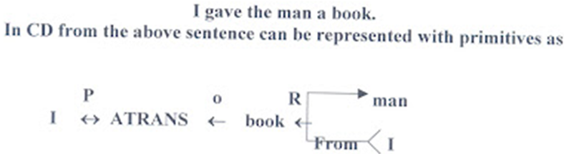
CD
It is independent of the language in which the sentences were originally stated.
CD representations of a sentence is built out of primitives, which are not words belonging to the language but are conceptual
These primitives are combined to form the meanings of the words
As an example consider the event represented by the sentence

Slide 61

Few conventions
In this representation the symbols have the following meaning:
Arrows indicate direction of dependency
Double arrow indicates two way link between actor and action
ATRANS is one of the primitive acts used by the theory.
It indicates transfer of possession
O- for the object case relation
R- for the recipient case relation
P- for past tense
D- for destination {*not used in this representation}

Slide 62
This representation is same for different saying with same meaning.
For example
I gave the man a book.
The man got book from me.
The book was given to man by me etc.

Slide 63
It has been used by many programs that pretend to understand English (MARGIE, SAM, PAM).
CD provides:
a structure into which nodes representing information can be placed
a specific set of primitives
at a given level of granularity.
Sentences are represented as a series of diagrams depicting actions using both abstract and real physical situations.
The agent and the objects are represented
The actions are built up from a set of primitive acts which can be modified by tense.

Slide 64
Primitive Acts of CD theory
ATRANS
-- Transfer of an abstract relationship. e.g. give.
PTRANS
-- Transfer of the physical location of an object. e.g. go.
PROPEL
-- Application of a physical force to an object. e.g. push.
MTRANS
-- Transfer of mental information. e.g. tell.
MBUILD
-- Construct new information from old. e.g. decide.
SPEAK
-- Utter a sound. e.g. say.
ATTEND
-- Focusing of a sense organ toward a stimulus. e.g. listen, watch.
MOVE
-- Movement of a body part by owner. e.g. punch, kick.
GRASP
-- Actor grasping an object. e.g. clutch.
INGEST
-- Actor ingesting an object. e.g. eat.
EXPEL
-- Actor getting rid of an object from body. e.g. cry

Slide 65
Six primitive conceptual categories
provide building blocks which are the set of allowable dependencies in the concepts in a sentence
PP
Real world objects. {Picture producer}
ACT
Real world actions {one of the CD Primitives}
PA
Attributes of objects {Picture aiders}
AA
Attributes of actions {Action aiders}
T
Times
LOC
Locations

Slide 66
The use of tense and mood in describing events
p- past
f- future
t- transition
t_{s}- start transition
t_{f}- Finished transition
k- continuing
?- introgative
/- negative
Nil- Present
delta- timeless
c- conditional
The absence of any modifier implies the present tense

Slide 67
Rule 1: PP ⬄ ACT
It describes the relationship between an actor and the event he/she causes
This is a two way dependency, since neither actor nor event can be considered primary
The letter p in the dependency link indicates past tense.
Example
John ran
CD Representation John ⬄PTRANS

Slide 68
Rule 2: ACT ← PP
It describes the relationship between a ACT and a PP (object) of ACT
The direction of the arrow is toward the ACT since the context of the specific ACT determines the meaning of the object relation
Example: John pushed the bike
CD Representation: John ⬄ PROPEL ← bike

Slide 69
Rule 3: PP↔ PP
It describes the relationship between two PP’s, one of which belongs to the set defined by the other.
Example: John is doctor.
CD Representation: John ↔ doctor

Slide 70

Rule 4: PP ← PP
It describes the relationship between two PP’s, one of which provides a particular kind of information about the other.
The three most common types of information to be provided in this way are possession (shown as POSS-BY), location (shown as LOC), and physical containment (Shown as CONT)
The direction of the arrow is again toward the concept being described.
Example: John’s dog
CD representation: dog John

Slide 71
Rule 5: PP⬄PA
It describes the relationship between a PP and a PA that is asserted to describe it.
PA represents states of PP such as height, health etc.
Example: John is fat
CD representation: John ⬄ weight (>80)

Slide 72
Rule 6: PP ←PA
It describes the relationship between a PP and an attribute that already has been predicated of it.
Direction is towards PP being described.
Example: Smart John
CD Representation: John ← smart

Slide 73

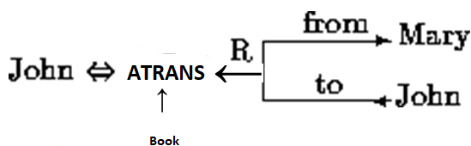
Rule 7: ACT ←R
It describes the relationship between an ACT and the source and the recipient of the ACT
Example: John took the book from Mary
CD Representation:

Slide 74


Rule 8: PP
It describes the relationship that describes the change in state.
Example: Tree grows
CD Representation:

Slide 75


Rule 9:
It describes the relationship between one conceptualization and another that causes it.
Here {x} causes {y} i.e., if x then y
Example: Bill shot Bob. Bob’s heath is poor.
CD Representation:

Slide 76


Rule 10:
It describes the relationship between one conceptualization with another that is happening at the time of the first
Here {y} is happening while {x} is in progress.
Example: while going home I saw a snake

Slide 77
Primitive states
Primitive states are used to describe many state descriptions such as height, health, mental state, physical state.
here are many more physical states than primitive actions. They use a numeric scale.
E.g. John ⬄ height(+10) John is the tallest
John⬄height(< average) John is short
Frank Zappa ⬄ health(-10) Frank Zappa is dead
Dave ⬄mental_state(-10) Dave is sad
Vase ⬄physical_state(-10) The vase is broken

Slide 78
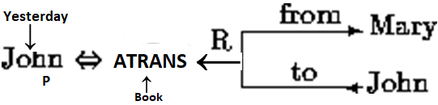
You can also specify things like the time of occurrence in the relation ship.
For Example: John gave Mary the book yesterday
Now let us consider a more complex sentence
Since smoking can kill you, I stopped
Lets look at how we represent the inference that smoking can kill:
Use the notion of one to apply the knowledge to.
Use the primitive act of INGESTing smoke from a cigarette to one.
Killing is a transition from being alive to dead. We use triple arrows to indicate a transition from one state to another.
Have a conditional, c causality link. The triple arrow indicates dependency of one concept on another.

Slide 79
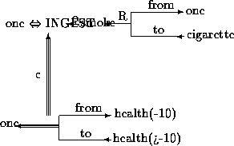

Slide 80
To add the fact that I stopped smoking
Use similar rules to imply that I smoke cigarettes.
The qualification t_{fp} attached to this dependency indicates that the instance INGESTing smoke has stopped.

Slide 81
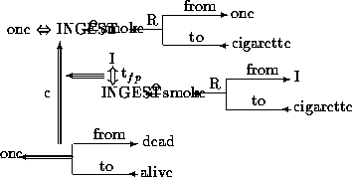

Slide 82
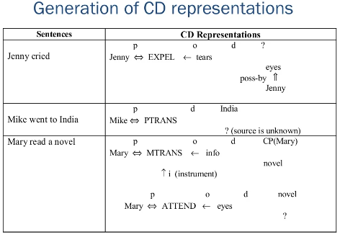

Slide 83
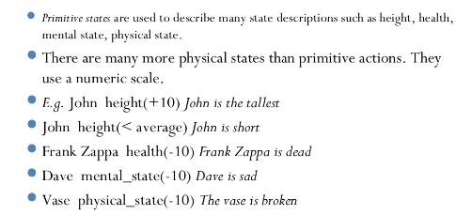

Slide 84
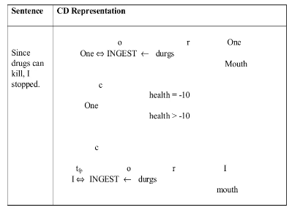

Slide 85
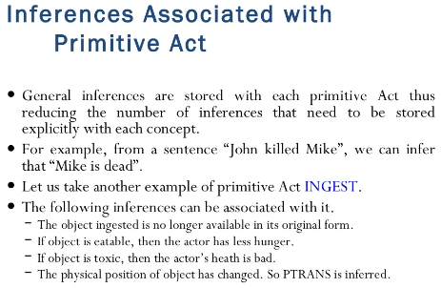

Slide 86
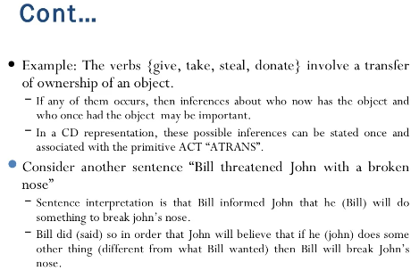

Slide 87
Advantages of CD
Using these primitives involves fewer inference rules.
Many inference rules are already represented in CD structure.
The holes in the initial structure help to focus on the points still to be established.

Slide 88
Disadvantages of CD
Knowledge must be decomposed into fairly low level primitives.
Impossible or difficult to find correct set of primitives.
A lot of inference may still be required.
Representations can be complex even for relatively simple actions. Consider:Dave bet Frank five pounds that Wales would win the Rugby World Cup.
Complex representations require a lot of storage

Slide 89
Applications of CD
MARGIE (Meaning Analysis, Response Generation and Inference on English)
model natural language understanding.
SAM (Script Applier Mechanism)
Scripts to understand stories. See next section.
PAM (Plan Applier Mechanism)
Scripts to understand stories.
Schank et al. developed all of the above.

Slide 90
Ontologies
an ontology is a formal explicit description of concepts in a domain of discourse (classes (sometimes called concepts)), properties of each concept describing various features and attributes of the concept (slots (sometimes called roles or properties)), and restrictions on slots (facets (sometimes called role restrictions)).
An ontology together with a set of individual instances of classes constitutes a knowledge base.

Slide 91
Classes are the focus of most ontologies.
Classes describe concepts in the domain.
For example, a class of wines represents all wines.
Specific wines are instances of this class.
The Bordeaux wine in the glass in front of you while you read this document is an instance of the class of Bordeaux wines.
A class can have subclasses that represent concepts that are more specific than the superclass.
For example, we can divide the class of all wines into red, white, and rosé wines.
Alternatively, we can divide a class of all wines into sparkling and non-sparkling wines.

Slide 92
Slots describe properties of classes and instances: Château Lafite Rothschild Pauillac wine has a full body;
It is produced by the Château Lafite Rothschild winery.
We have two slots describing the wine in this example:
the slot body with the value full and the slot maker with the value Château Lafite Rothschild winery.
At the class level, we can say that instances of the class Wine will have slots describing their flavor, body, sugar level, the maker of the wine and so on.
All instances of the class Wine, and its subclass Pauillac, have a slot maker the value of which is an instance of the class Winery.
All instances of the class Winery have a slot produces that refers to all the wines (instances of the class Wine and its subclasses) that the winery produces.

Slide 93
In practical terms, developing an ontology includes:
defining classes in the ontology,
arranging the classes in a taxonomic (subclass–superclass) hierarchy,
defining slots and describing allowed values for these slots,
filling in the values for slots for instances.
We can then create a knowledge base by defining individual instances of these classes filling in specific slot value information and additional slot restrictions.
Suggested Readings: https://protege.stanford.edu/publications/ontology_development/ontology101-noy-mcguinness.html

Slide 94
Scripts
A script is a structured representation describing a stereotyped sequence of events in a particular context.
Scripts are used to organize events in knowledge bases
Scripts are very related to the idea of frames

Slide 95
Components of a Script
A script is composed of several components
Entry conditions that must be true for the script to be called
Results or facts that are true once the script has terminated
Props or the ”things” that make up the content of the script
Roles are the actions that the individual participants perform
Scenes which present temporal aspects of the script

Slide 96
Canonical Example: Restaurant Visit
Objects: tables, menu, food, check, money, ...
Roles: customer, waiter, cook, cashier, owner, ...
Entry conditions: customer hungry, customer has money
Results: customer not hungry, customer has less money, owner more money, ...
Scenes
Scene 1: Entering
customer enters restaurant
customers looks at tables
customer decides where to sit
...
Scene 2: Ordering
waiter brings menu
...
...

Slide 97
Script Actions

Slide 98
Detailed Script

